Slide 1

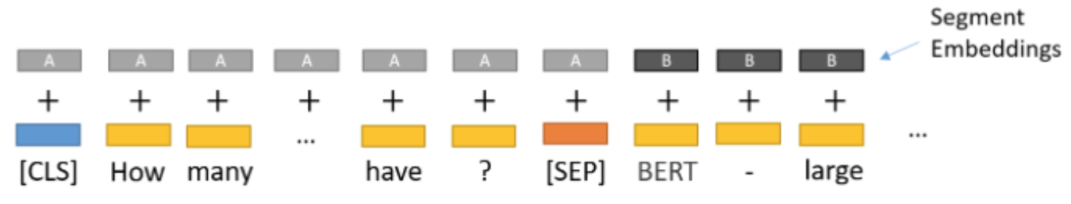
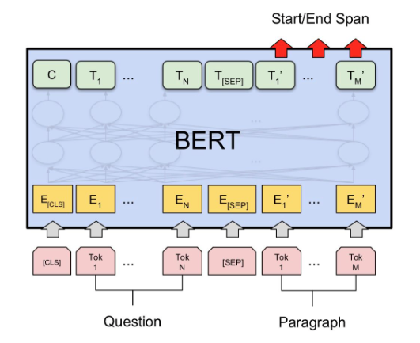
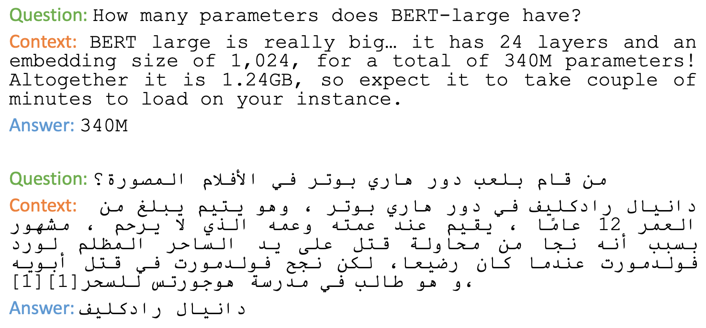
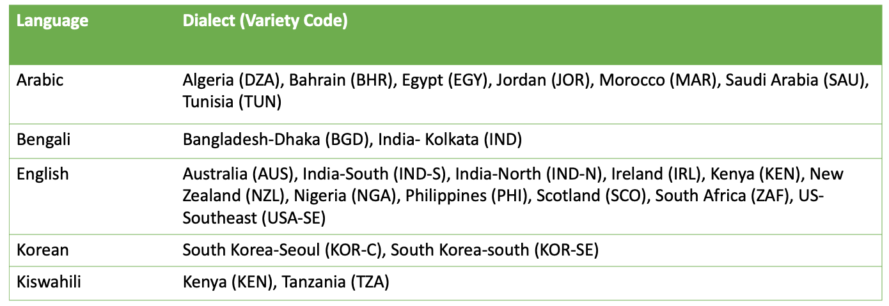
Dialectal Extractive Question Answer
Adel Alhamisy, Aniket Pandey, Pankaj Jatav, Yash Bagal
{aalkhami, apandey7, pjatav, ybagal}@gmu.edu
Abstract
We build a QA system that can recognize different languages dialects and output an answer in response to a question. The current QA systems do not consider the faults that might be introduced by different dialects. We propose a BERT with Language-Clustered vocabulary (Chung et al., 2020) or Poolingformer (Zhang et al., 2021) in an effort to improve the performance.
Architecture
Question
Context
Dataset – 5 Languages, 24 Dialects
Analysis / Experiments
The ffaisal93/DialQA uses bert-base-multilingual-uncased which has normalization issue in many languages and therefore according to the official BERT documentation it is not recommended so, we switched to bert-base-multilingual-cased model which comprises of 104 languages.
Using the bert-base-multilingual-uncased we got an average accuracy of 70% on all languages.
We are working on using Poolingformer which beats previous state of the art model TyDi QA by 1.9 points.
CS-678: Advanced NLP
Department of Computer Science
School of Computing

